Slide 1
INTRODUCING
CADENCE
MEMBER CARE PERFORMANCE
Member Care's month, in one place.
November 2026
Member Care · WFM team
Notes:
Introducing Cadence: Member Care's month, in one place. One shared place where every role works from the same numbers, every number is settled before it counts, and every result is explained to the person it touches. In the next minutes: the problem, the idea, what Member Care gets, every role, trust, and what comes next.

Slide 2
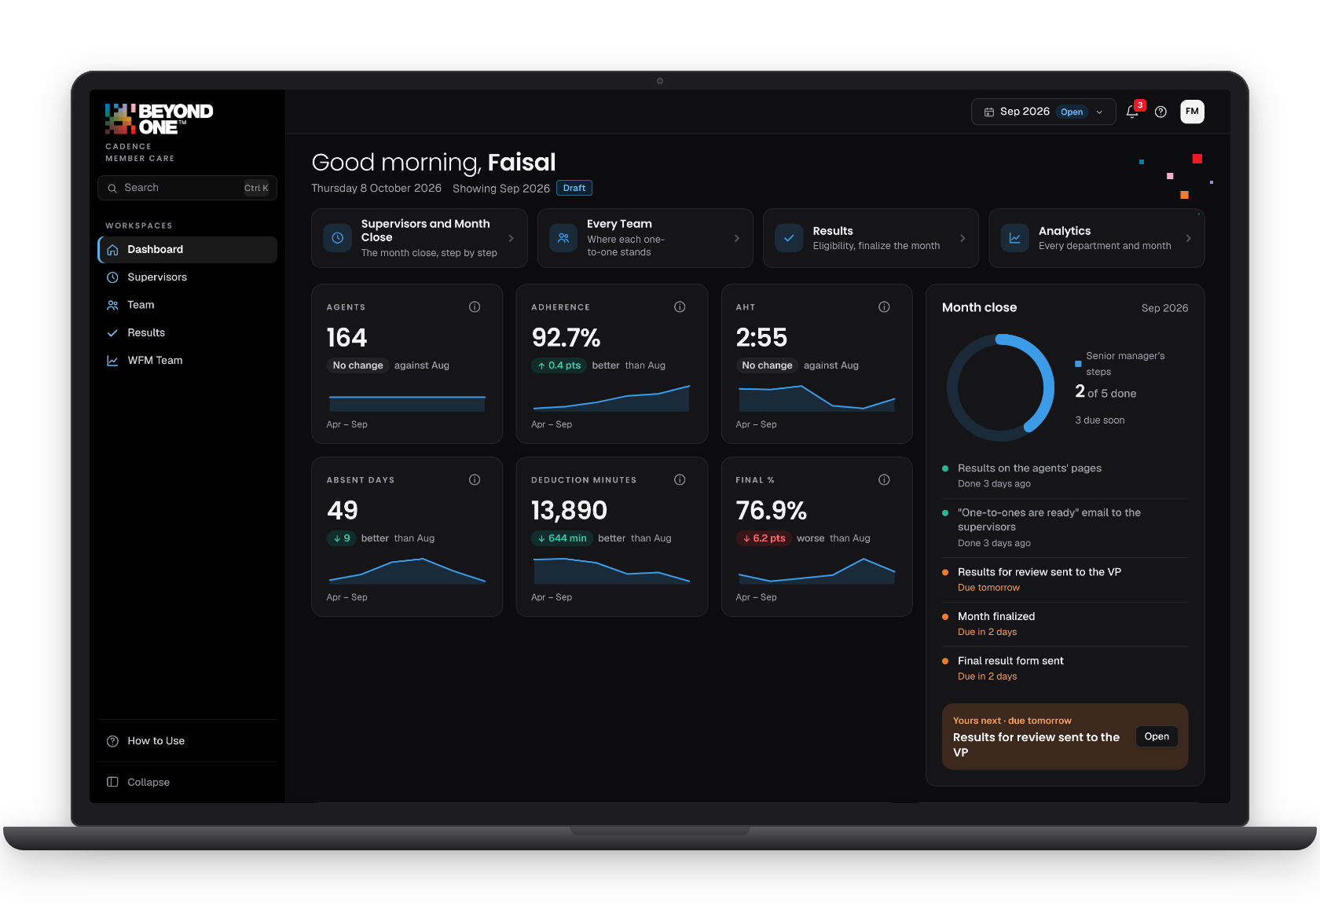



MEMBER CARE'S MONTH, IN ONE PLACE
THE IDEA
One shared truth for the whole month: the numbers every role works from, settled before they count, and explained to the person they touch.
One truth for every role
Seven roles on the same numbers, the same day.
Right before it counts
Questions settled before anything goes out.
Every number explained
Anyone can see how a result was reached.
A page for every role
Works offline
Encrypted
Notes:
The idea in one line: Member Care's month, in one place. One shared truth for the whole month: the numbers every role works from, settled before they count, and explained to the person they touch. Three promises: one truth for every role, right before it counts, and every number explained.

Slide 3



MONTH END RAN ON PEOPLE AND SPREADSHEETS
THE CHALLENGE
10+
sources of numbers
Hours spent assembling
Skilled people joined and checked numbers instead of improving service.
7
Hard to explain, easy to dispute
roles on the same numbers
A question about pay meant reopening the spreadsheets.
1
The month lived with one person
When they were away, the month waited.
deadline for all of it
Notes:
Month end used to run on people and spreadsheets: numbers from more than ten places, joined by hand, for seven roles waiting on one deadline. Skilled people spent their month assembling instead of improving service; a question about a bonus meant reopening the spreadsheets; and when one person was away, the month waited.

Slide 4
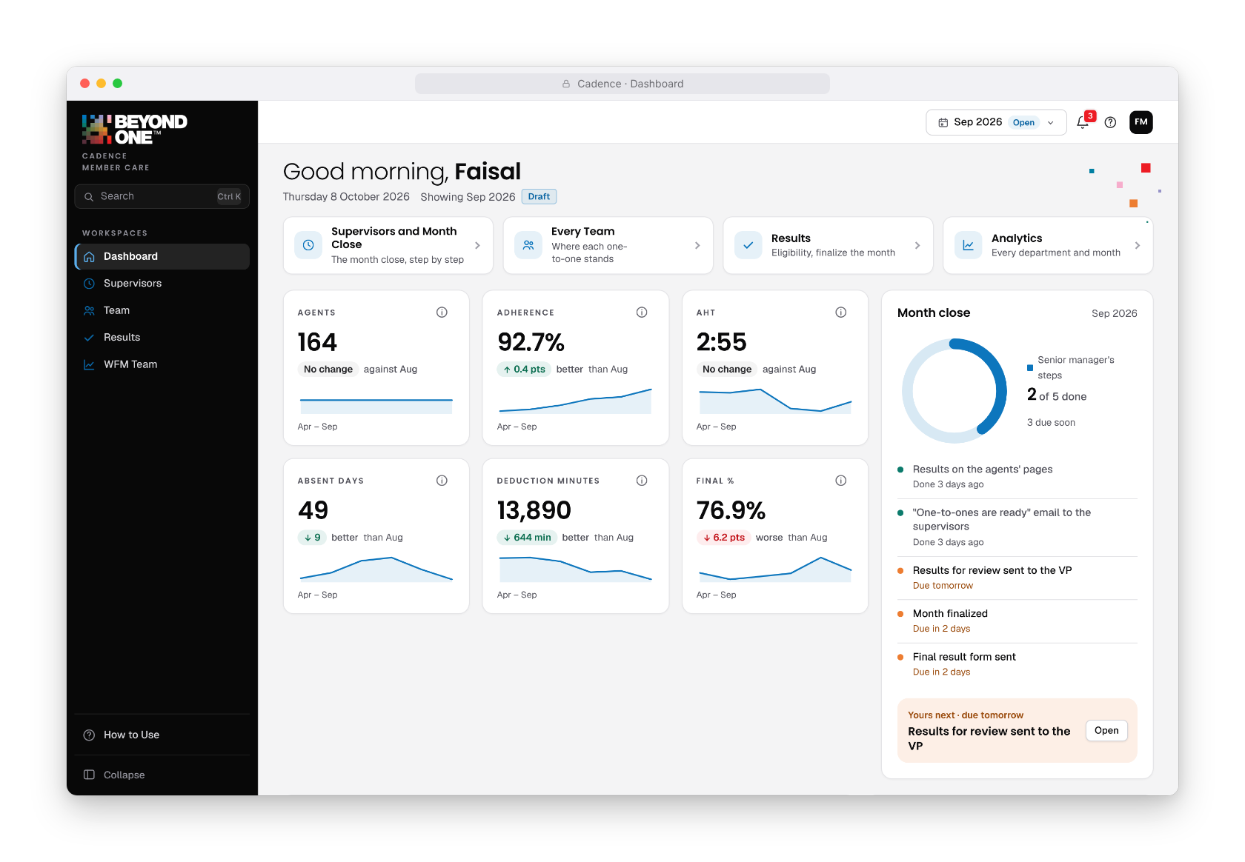
EVERYONE ON THE SAME MONTH
THE IDEA
4
1
Next, for your role
What this person does next, one click away.
1
2
3
2
The month at a glance
Every number with its trend.
3
The month close
Each step, done or due, and whose turn it is.
4
Nobody chases
Each person's own deadlines, in the bell.
Notes:
This is the idea on screen: everyone opens the same month. One: what this person does next, one click away. Two: the month at a glance, each number against the month before. Three: the month close, step by step, and whose turn it is. Four: the bell keeps each person's deadlines, so nobody has to chase anyone.

Slide 5





WHAT MEMBER CARE GETS
WHAT MEMBER CARE GETS
Time back for people
Fewer errors and disputes
Fairness people can see
The hours that went into assembling numbers go back to coaching, quality and service.
Problems are settled before anything goes out, so fewer corrections follow.
Every bonus explains itself; the same rules for everyone; agents see their own.
The month at a glance
No single point of failure
Private by design
Managers see where the close stands, what is late and who is next.
Shared, saved and covered during holidays: never one person's spreadsheet.
The data stays on our own computers, encrypted; each role sees only its own.
Notes:
What Member Care gets, in six parts: time back for people; fewer errors and fewer disputes; fairness everyone can see; the month at a glance for every manager; no single point of failure; and privacy by design. Each is something the team can feel in the first month.

Slide 6



TIME BACK FOR PEOPLE
TIME BACK
Measured with the team's own numbers in the first month.
Hours back = people × ( hours today − hours with Cadence )
WFM analysts
Supervisors
Managers
From assembling to analysis
From paperwork to coaching
From chasing to deciding
The month's numbers come together and are checked for them.
The one-to-one fills itself from the month's numbers.
Where the close stands and who is next, at a glance.
Notes:
Time back is the first thing the team will feel. The measure is simple: the people in a role, times the hours each gives month end today, minus the hours with Cadence. We measure it with the team's own numbers in the first month. Analysts move from assembling to analysis, supervisors from paperwork to coaching, managers from chasing to deciding.

Slide 7
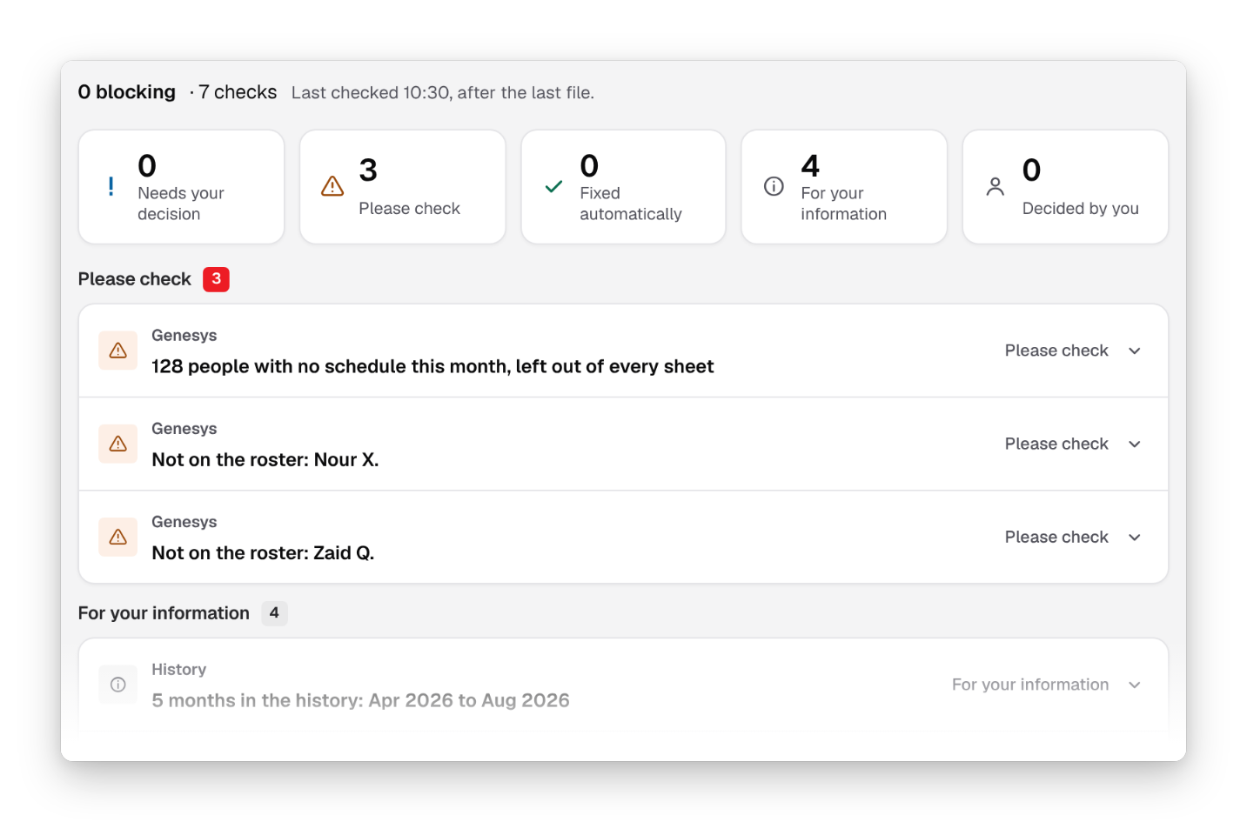
SETTLED BEFORE IT COUNTS
RIGHT THE FIRST TIME
Problems are settled before a number reaches a payslip or an email.
Decided first
Nothing counts until someone decides.
Every decision kept
Who decided, and when.
One version
The same month for everyone.
Notes:
Right the first time. Problems surface before anything counts: the questions that matter hold the month until someone decides, and every decision is kept with who made it and when. So fewer corrections follow the emails, and fewer surprises reach agents.

Slide 8
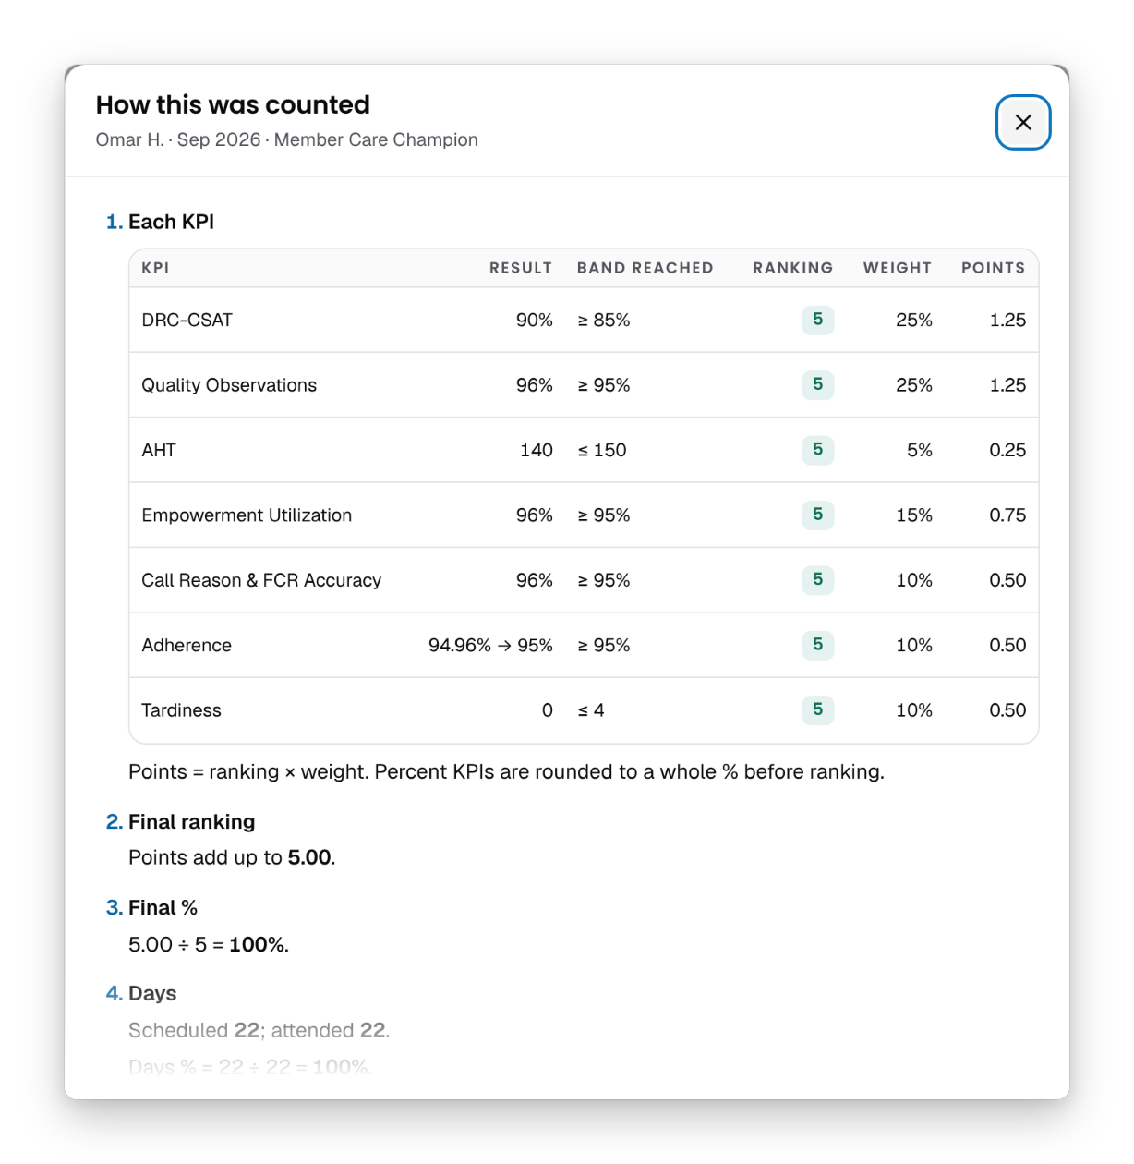
FAIRNESS PEOPLE CAN SEE
FAIRNESS
94.96% → 95%
The same rounding for everyone, shown in every result.
One set of rules
Kept by the senior manager; every change logged.
Every person, step by step
Each KPI, band, ranking and points, then the days and the amount.
Agents see their own
Their own results, explained, in English or Arabic.
Notes:
Fairness people can see. For any agent, every result explains itself: each KPI with its result, band, ranking and points, then the days and the amount. The same rules apply to everyone, kept by the senior manager with every change logged, and agents see their own results. A question about pay is answered in a click.

Slide 9
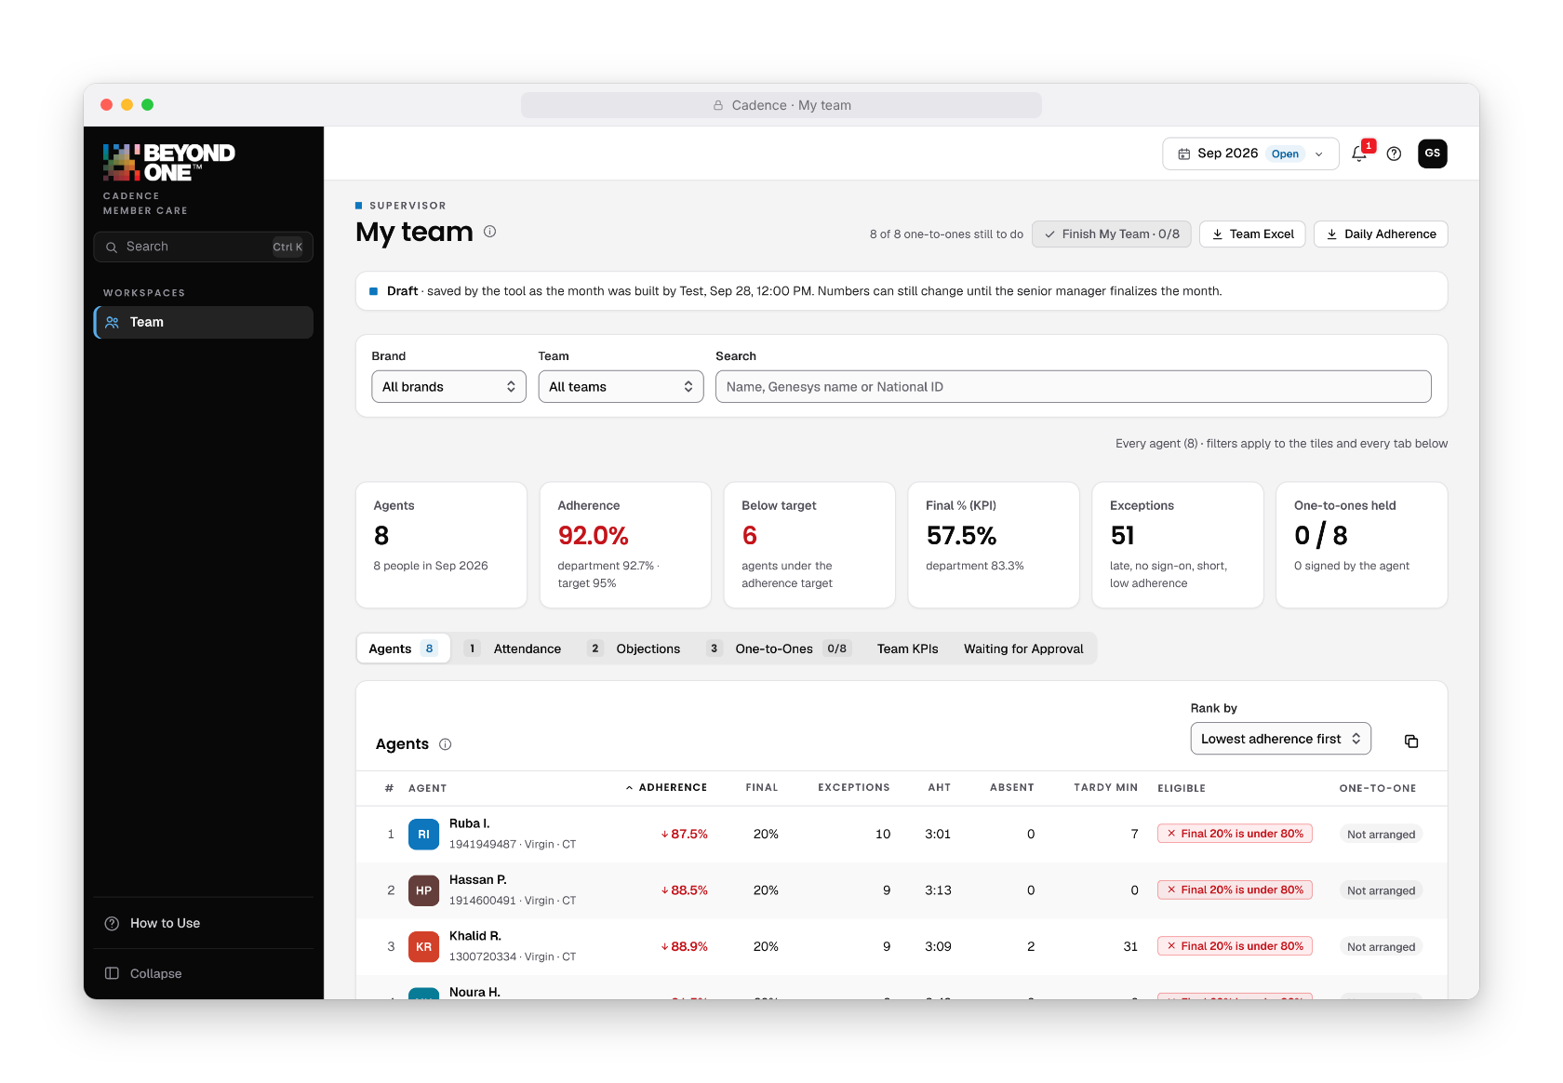


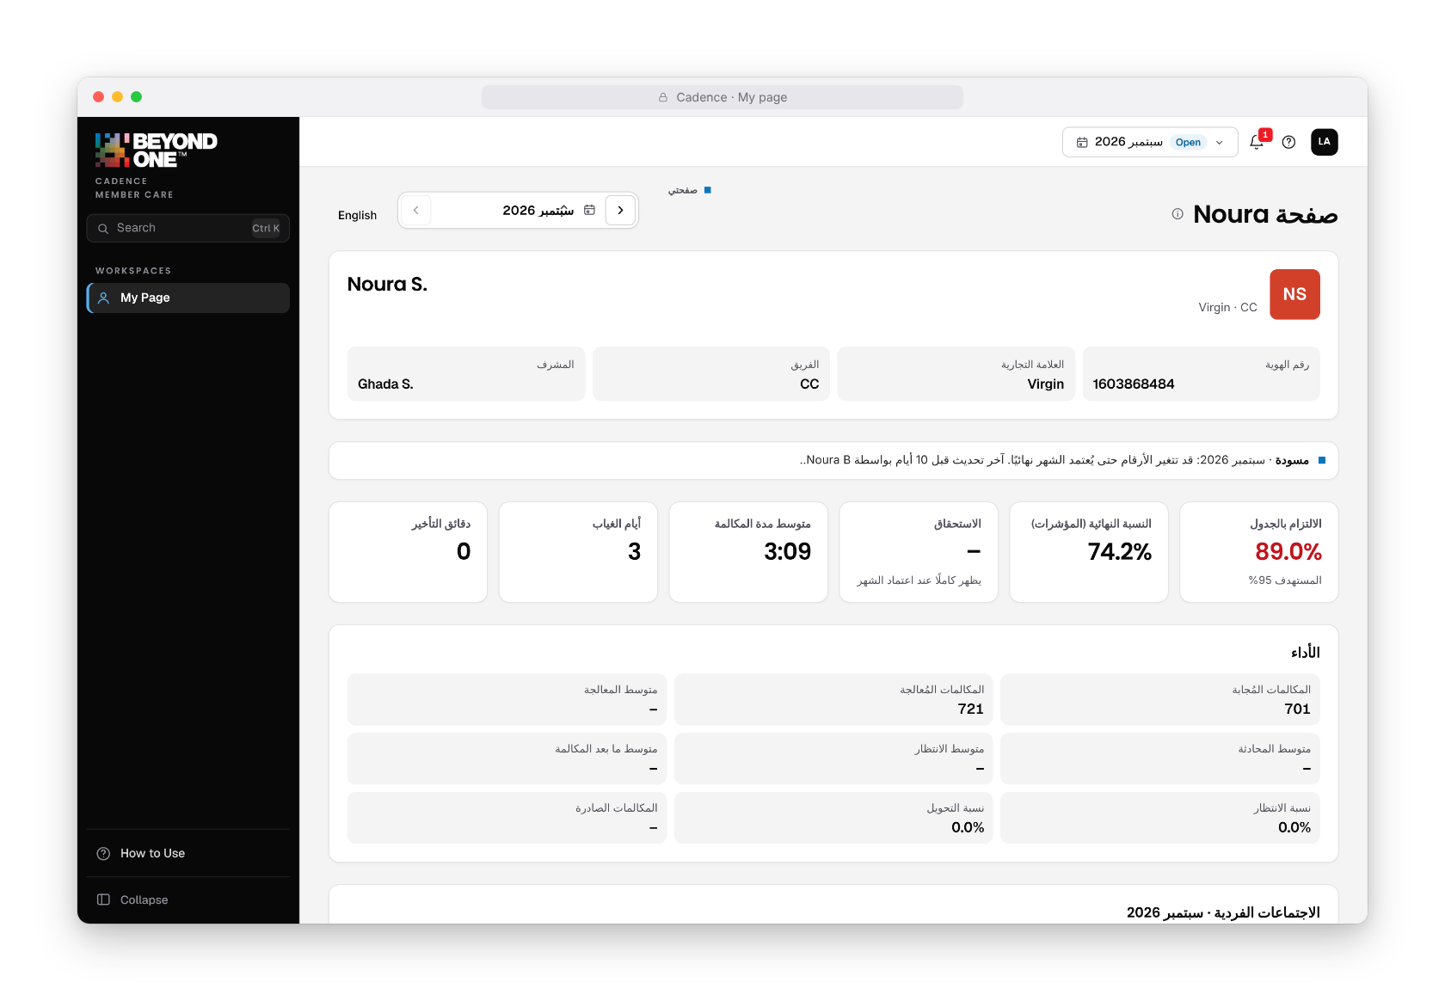

A BETTER MONTH FOR EVERY ROLE
EVERY ROLE
WFM analyst
Time for analysis, not assembling
WFM manager
Checked numbers, sent on time
Senior manager
The whole close, every number explained
Supervisor
More coaching, less paperwork
Quality team
Quality entered once, counted everywhere
Agent
Own results, understood, English or Arabic
Admin
Each person in their role
Notes:
Every role gets a better month, on its own page, seeing only what is theirs. WFM analysts spend their time on analysis; the WFM manager sends checked numbers on time; the senior manager sees the whole close and decides with every number explained; supervisors coach from the month's own numbers; the quality team enters quality once; agents see and understand their own results; and the admin gives each person their role.

Slide 10
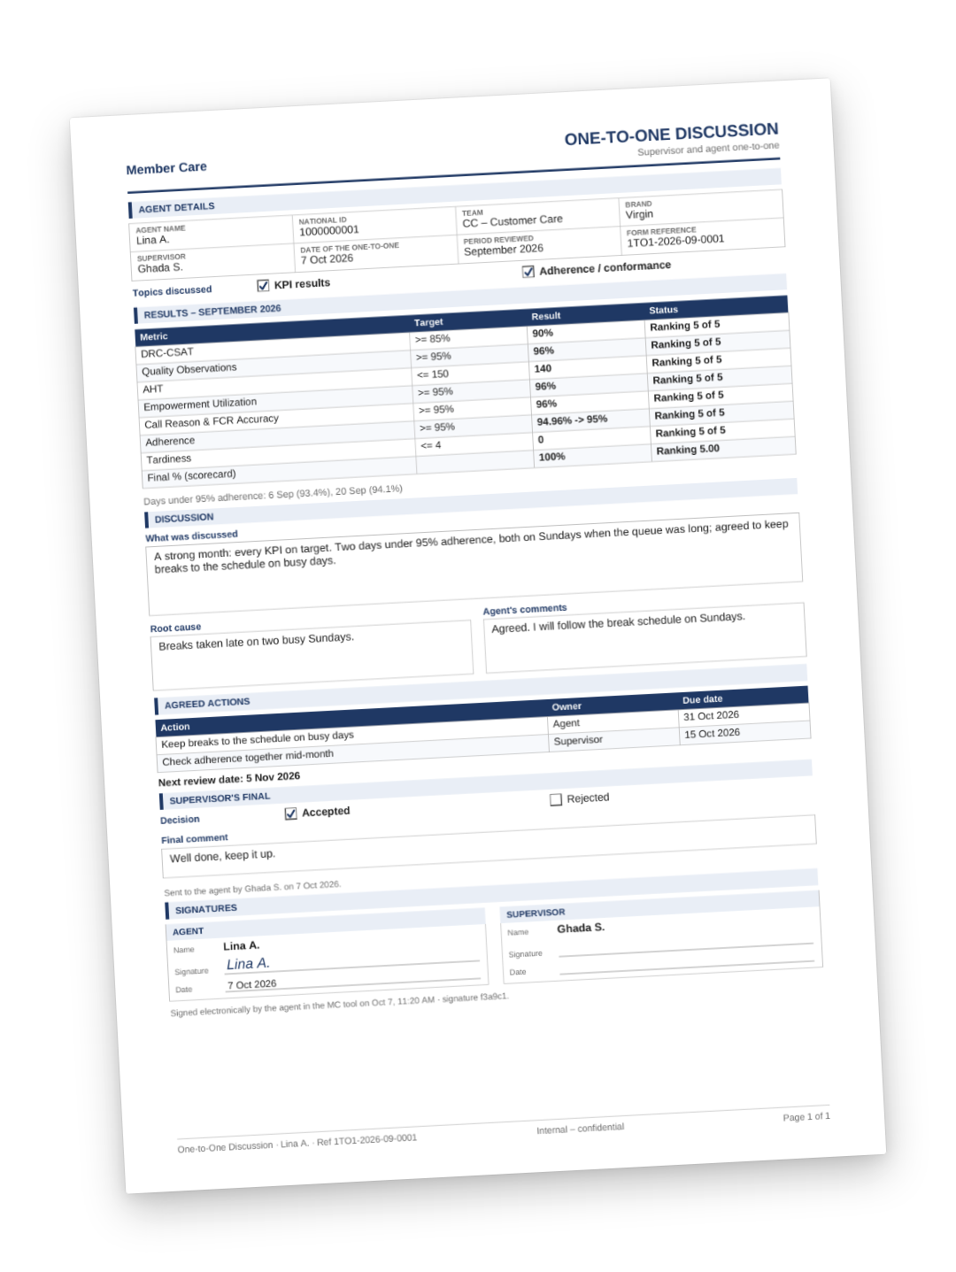

THE COACHING LOOP, CLOSED
COACHING
1
2
Results shared
One-to-one
Each agent sees the month on their own page.
Filled from the numbers, on one A4 page.
4
3
Questions answered
Signed together
Supervisor first; the senior manager decides.
The agent comments and signs after the supervisor.
Notes:
The coaching loop is closed in one place. Results reach each agent's own page; the one-to-one is filled from the month's numbers and fits on one A4 page; the agent comments and signs after the supervisor; and if an agent disagrees with a number, the supervisor answers first and the senior manager decides. Better conversations, on the same facts.

Slide 11
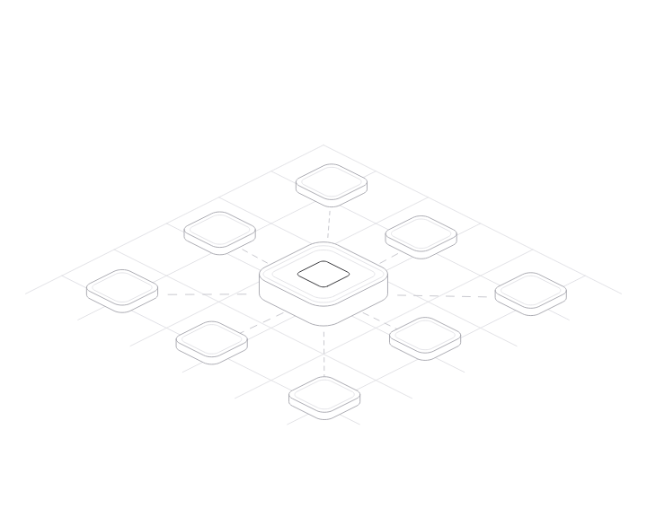


A MONTH THAT NEVER WAITS ON ONE PERSON
CONTINUITY
Shared by every role
One month, one set of numbers, for everyone who needs it.
Saved as the work happens
Nothing lives in one person's spreadsheet; the history builds itself.
Covered during holidays
A colleague takes over a role's pages until they are back.
Nobody chases
Everyone sees the close and their own deadlines.
Notes:
The month never waits on one person. Every role shares the same month, it is saved as the work happens, and when someone is on holiday a colleague covers their pages until they are back. Everyone sees where the close stands, so nobody has to chase anyone.

Slide 12
YOUR DATA STAYS YOURS
PRIVATE BY DESIGN
0
AES-256
No IDs
web requests
encrypted shared data
in email attachments
Nothing is sent anywhere: the data stays on our own computers.
Only accounts made in the tool can read it.
National IDs never leave the tool in an email.
By role
Reviewed
Logged
what each person sees
for security
every change
An agent sees only their own page; a supervisor, only their team.
Every finding fixed and covered by tests.
Results, rules and roles: who changed what, and when.
Notes:
The data is the most sensitive Member Care has: names, National IDs, results and money. It stays on our own computers and is sent nowhere. The shared data is encrypted with AES-256 and only accounts made in the tool can read it. Attachments carry no National IDs. Each role sees only what is theirs, a security review was done, and every change is logged.

Slide 13
TESTED LIKE A PRODUCT
BUILT TO BE RIGHT
10,000
37
7
synthetic people
browser test suites
roles
run through every counting rule, with the expected results
run before every change ships
every page checked,
in light and dark
Every calculation, email and permission is covered by tests that run before each change ships.
Notes:
It is tested like a product. Every counting rule runs over ten thousand synthetic people with the expected results. Thirty-seven automated browser test suites run before every change ships. Every role's pages are checked, in light and dark.

Slide 14

WHAT CHANGES FOR MEMBER CARE
WHAT CHANGES
 | Before | With Cadence
Time | Assembling and checking by hand | Spent on coaching and service
Accuracy | Mistakes found after the emails | Settled before anything goes out
Questions about pay | Worked out again on request | Answered in a click
Visibility | Status gathered by email and calls | The whole month at a glance
Continuity | The month in one person's files | Shared, saved and covered
Same team, same rules: a better month.
Month end runs on one shared truth instead of people and spreadsheets.
Notes:
What changes for Member Care, in one view: time moves from assembling to coaching; mistakes are settled before anything goes out; questions about pay are answered in a click; the whole month is visible to every role; and the month no longer rests on one person.

Slide 15

READY FOR THE NEXT CLOSE
WHAT COMES NEXT
1
Run the next month end in Cadence
every role in one place, the old way beside it for one month.
2
Measure what it gives back
hours, corrections and questions about pay, against the month before.
3
Make it how we close
every month, every role, one shared truth.
Next: open it from anywhere, phones included.
THANK YOU
Notes:
What comes next, in three steps: run the next month end in Cadence, with the old way beside it for one month; measure what it gives back, hours, corrections and questions about pay, against the month before; then make it how Member Care closes every month. Next: opening it from anywhere, phones included. Thank you, and questions.

